Slide 1

Tools & techniques
Wenxuan Shi
College of Software, Nankai University
Email: shiwx@nankai.edu.cn
Wechat: 13920561100

Slide 2
Topics
Android Studio & IntelliJ
Visual Studio Code
DevTools
Hot reload

Slide 3
Installation and setup
Notes:
StatelessWidget is used for immutable elements that only rely on the object configuration information
StatefulWidget is used for elements that can dynamically change based on state-changes in the system
Everytime that state changes, setChange() is called by the object

Slide 4
Installation and setup
Updating the plugins
Updates to the plugins are shipped on a regular basis. You should be prompted in the IDE when an update is available.
To check for updates manually:
Open preferences (Android Studio > Check for Updates on macOS, Help > Check for Updates on Linux).
If dart or flutter are listed, update them.

Slide 5
Creating projects
Creating a new project
To create a new Flutter project from the Flutter starter app template:
In the IDE, click Create New Project from the Welcome window or File > New > Project from the main IDE window.
Select Flutter in the menu, and click Next.
Enter your desired Project name and Project location.
If you might publish this app, set the company domain.
Click Finish.

Slide 6
Creating a new project from existing source code
To create a new Flutter project containing existing Flutter source code files:
In the IDE, click Create New Project from the Welcome window or File > New > Project from the main IDE window.
Select Flutter in the menu, and click Next.
Under Project location enter, or browse to, the directory holding your existing Flutter source code files.
Click Finish.

Slide 7
Editing code and viewing issues
The Flutter plugin performs code analysis that enables the following:
Syntax highlighting.
Code completions based on rich type analysis.
Navigating to type declarations (Navigate > Declaration), and finding type usages (Edit > Find > Find Usages).
Viewing all current source code problems (View > Tool Windows > Dart Analysis). Any analysis issues are shown in the Dart Analysis pane:

Slide 8
Running and debugging
Note: You can debug your app in a few ways.
Using DevTools, a suite of debugging and profiling tools that run in a browser and include the Flutter inspector. DevTools replaces the previous browser-based profiling tool, Observatory.
Using Android Studio’s (or IntelliJ’s) built-in debugging features, such as the ability to set breakpoints.
Using the Flutter inspector, directly available in Android Studio and IntelliJ.

Slide 9
Selecting a target
When a Flutter project is open in the IDE, you should see a set of Flutter-specific buttons on the right-hand side of the toolbar.
Locate the Flutter Target Selector drop-down button. This shows a list of available targets.
Select the target you want your app to be started on. When you connect devices, or start simulators, additional entries appear.

Slide 10
Run app without breakpoints
Click the Play icon in the toolbar, or invoke Run > Run. The bottom Run pane shows logs output.

Slide 11
Run app with breakpoints
If desired, set breakpoints in your source code.
Click the Debug icon in the toolbar, or invoke Run > Debug.
The bottom Debugger pane shows Stack Frames and Variables.
The bottom Console pane shows detailed logs output.
Debugging is based on a default launch configuration. To customize this, click the drop-down button to the right of the device selector, and select Edit configuration.

Slide 12
Fast edit and refresh development cycle
Flutter offers a best-in-class developer cycle enabling you to see the effect of your changes almost instantly with the Stateful Hot Reload feature.
See Hot reload for details.

Slide 13
Show performance data
To view the performance data, including the widget rebuild information, start the app in Debug mode, and then open the Performance tool window using View > Tool Windows > Flutter Performance.

Slide 14
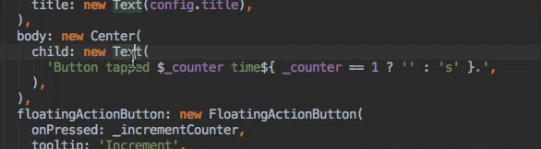
Editing tips for Flutter code
Assists & quick fixes
Assists are code changes related to a certain code identifier.
The assist can be invoked by clicking the lightbulb, or by using the keyboard shortcut (Alt+Enter on Linux and Windows, Option+Return on macOS), as illustrated here:

Slide 15
Wrap with new widget assist: This can be used when you have a widget that you want to wrap in a surrounding widget, for example if you want to wrap a widget in a Row or Column.
Wrap widget list with new widget assist: Similar to the assist above, but for wrapping an existing list of widgets rather than an individual widget.
Convert child to children assist: Changes a child argument to a children argument, and wraps the argument value in a list.

Slide 16
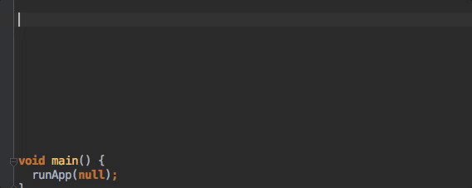
Live templates
Live templates can be used to speed up entering typical code structures. They are invoked by typing their prefix, and then selecting it in the code completion window:

Slide 17
The Flutter plugin includes the following templates:
Prefix stless: Create a new subclass of StatelessWidget.
Prefix stful: Create a new subclass of StatefulWidget and its associated State subclass.
Prefix stanim: Create a new subclass of StatefulWidget and its associated State subclass, including a field initialized with an AnimationController.
You can also define custom templates in Settings > Editor > Live Templates.

Slide 18
Keyboard shortcuts
Hot reload
On Linux (keymap Default for XWin) and Windows the keyboard shortcuts are Controle+Alt+; and Control+Backslash.
On macOS (keymap Mac OS X 10.5+ copy) the keyboard shortcuts are Command+Option and Command+Backslash.

Slide 19
Editing Android code in Android Studio
If you already have the entire project opened as a Flutter app in Android Studio, there are two equivalent ways to open the Android files on their own for editing in the IDE.
In the “project view”, you should see a subdirectory immediately under the root of your flutter app named android. Right click on it, then select Flutter > Open Android module in Android Studio.
OR, you can open any of the files under the android subdirectory for editing. You should then see a “Flutter commands” banner at the top of the editor with a link labeled Open for Editing in Android Studio. Click that link.

Slide 20
If you don’t already have the Flutter project opened in Android studio, you can open the Android files as their own project from the start:
Click Open an existing Android Studio Project on the Welcome splash screen, or File > Open if Android Studio is already open.
Open the android subdirectory immediately under the flutter app root. For example if the project is called flutter_app, open flutter_app/android.

Slide 21
Editing Android code in IntelliJ IDEA
To enable editing of Android code in IntelliJ IDEA, you need to configure the location of the Android SDK:
In Preferences > Plugins, enable Android Support if you haven’t already.
Right-click the android folder in the Project view, and select Open Module Settings.
In the Sources tab, locate the Language level field, and select level 8 or later.
In the Dependencies tab, locate the Module SDK field, and select an Android SDK. If no SDK is listed, click New and specify the location of the Android SDK. Make sure to select an Android SDK matching the one used by Flutter (as reported by flutter doctor).
Click OK.

Slide 22
Tips and tricks
Flutter IDE cheat sheet, MacOS version
Flutter IDE cheat sheet, Windows & Linux version

Slide 23
Visual Studio Code
Notes:
StatelessWidget is used for immutable elements that only rely on the object configuration information
StatefulWidget is used for elements that can dynamically change based on state-changes in the system
Everytime that state changes, setChange() is called by the object

Slide 24
Installation and setup
Updating the extension
By default, VS Code automatically updates extensions when updates are available.
To install updates manually:
Click the Extensions button in the Side Bar.
If the Flutter extension is shown with an available update, click the update button and then the reload button.
Restart VS Code.

Slide 25
Creating projects
Creating a new project
To create a new Flutter project from the Flutter starter app template:
Open the Command Palette (Ctrl+Shift+P (Cmd+Shift+P on macOS)).
Select the Flutter: New Project command and press Enter.
Enter your desired Project name.
Select a Project location.

Slide 26
Opening a project from existing source code
To open an existing Flutter project:
Click File > Open from the main IDE window.
Browse to the directory holding your existing Flutter source code files.
Click Open.

Slide 27
Editing code and viewing issues
Editing code and viewing issues
The Flutter extension performs code analysis that enables the following:
Syntax highlighting
Code completions based on rich type analysis
Navigating to type declarations (Go to Definition or F12), and finding type usages (Find All References or Shift+F12)
Viewing all current source code problems (View > Problems or Ctrl+Shift+M (Cmd+Shift+M on macOS)) Any analysis issues are shown in the Problems pane:

Slide 28
Running and debugging
Note: You can debug your app in a couple of ways.
Using DevTools, a suite of debugging and profiling tools that run in a browser. DevTools replaces the previous browser-based profiling tool, Observatory, and includes functionality previously only available to Android Studio and IntelliJ, such as the Flutter inspector.
Using VS Code’s built-in debugging features, such as setting breakpoints.

Slide 29
Selecting a target device
When a Flutter project is open in VS Code, you should see a set of Flutter specific entries in the status bar, including a Flutter SDK version and a device name (or the message No Devices).

Slide 30
Run app without breakpoints
Click Debug > Start Without Debugging in the main IDE window, or press Ctrl+F5. The status bar turns orange to show you are in a debug session.

Slide 31
Run app with breakpoints
If desired, set breakpoints in your source code.
Click Debug > Start Debugging in the main IDE window, or press F5.
The left Debug Sidebar shows stack frames and variables.
The bottom Debug Console pane shows detailed logging output.
Debugging is based on a default launch configuration. To customize, click the cog at the top of the Debug Sidebar to create a launch.json file. You can then modify the values.

Slide 32
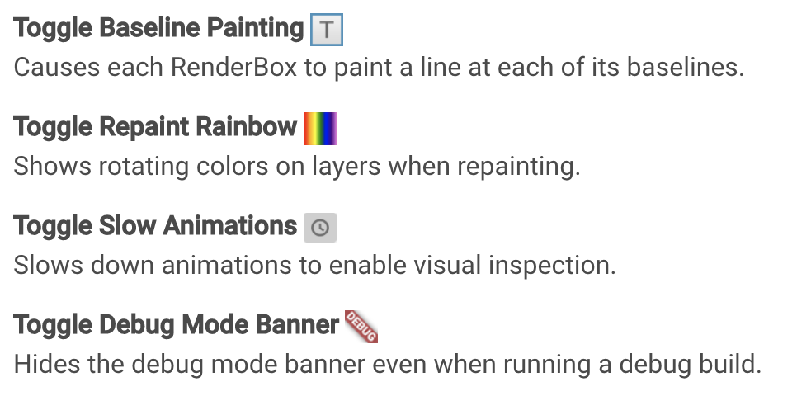
Advanced debugging
Debugging visual layout issues
During a debug session, several additional debugging commands are added to the Command Palette and to the Flutter inspector. When space is limited, the icon is used as the visual version of the label.

Slide 33
Debugging external libraries
By default, debugging an external library is disabled in the Flutter extension. To enable:
Select Settings > Extensions > Dart Configuration.
Check the Debug External Libraries option.

Slide 34
Editing tips for Flutter code
Assists & quick fixes
Assists are code changes related to a certain code identifier.
The assist can be invoked by clicking the lightbulb, or by using the keyboard shortcut Ctrl+. (Cmd+. on Mac), as illustrated here:

Slide 35
Wrap with new widget assist: This can be used when you have a widget that you want to wrap in a surrounding widget, for example if you want to wrap a widget in a Row or Column.
Wrap widget list with new widget assist: Similar to the assist above, but for wrapping an existing list of widgets rather than an individual widget.
Convert child to children assist: Changes a child argument to a children argument, and wraps the argument value in a list.

Slide 36
Snippets
Snippets can be used to speed up entering typical code structures.
They are invoked by typing their prefix, and then selecting from the code completion window:

Slide 37
The Flutter extension includes the following snippets:
Prefix stless: Create a new subclass of StatelessWidget.
Prefix stful: Create a new subclass of StatefulWidget and its associated State subclass.
Prefix stanim: Create a new subclass of StatefulWidget, and its associated State subclass including a field initialized with an AnimationController.

Slide 38
Keyboard shortcuts
Hot reload
During a debug session, clicking the Restart button on the Debug Toolbar, or pressing Ctrl+Shift+F5 (Cmd+Shift+F5 on macOS) performs a hot reload.
Keyboard mappings can be changed by executing the Open Keyboard Shortcuts command from the Command Palette.

Slide 39
Hot reload vs. hot restart
Hot reload works by injecting updated source code files into the running Dart VM (Virtual Machine).
A few types of code changes cannot be hot reloaded though:
Global variable initializers
Static field initializers
The main() method of the app
For these changes, fully restart your application without having to end your debugging session.

Slide 40
DevTools
Notes:
StatelessWidget is used for immutable elements that only rely on the object configuration information
StatefulWidget is used for elements that can dynamically change based on state-changes in the system
Everytime that state changes, setChange() is called by the object

Slide 41
What is DevTools?
DevTools is a suite of performance and debugging tools for Dart and Flutter.

Slide 42
What can I do with DevTools?
Inspect the UI layout and state of a Flutter app.
Diagnose UI jank performance issues in a Flutter app.
Source-level debugging of a Flutter or Dart command-line app.
Debug memory issues in a Flutter or Dart command-line app.
View general log and diagnostics information about a running Flutter or Dart command-line app.

Slide 43
How?
How do I install DevTools?
See the Android Studio/IntelliJ, VS Code, or command line pages for installation instructions.
How do I try DevTools written in Flutter?
To test the alpha version of DevTools written in Flutter, click the “beaker” icon in the upper-right corner of DevTools.

Slide 44
Install and run DevTools from Android Studio
Install the Flutter plugin
Install the Flutter plugin if you don’t already have it installed. This can be done using the normal Plugins page in the IntelliJ and Android Studio settings. Once that page is open, you can search the marketplace for the Flutter plugin.

Slide 45
Start an app to debug
To open DevTools, you first need to run a Flutter app. This can be accomplished by opening a Flutter project, ensuring that you have a device connected, and clicking the Run or Debug toolbar buttons.

Slide 46
Launch DevTools from the toolbar/menu
Once an app is running, you can start DevTools using one of the following:
Select the Open DevTools toolbar action in the Run view.
Select the Open DevTools toolbar action in the Debug view. (if debugging)
Select the Open DevTools action from the More Actions menu in the Flutter Inspector view.

Slide 47
Launch DevTools from an action
You can also open DevTools from an IntelliJ action. Open the Find Action… dialog (on a Mac, press Command+Shift+A), and search for the Open DevTools action.
When you select that action, DevTools is installed (if it isn’t already), the DevTools server launches, and a browser instance opens pointing to the DevTools app.

Slide 48
Install and run DevTools from VS Code
Install the VS Code extensions
To use the DevTools from VS Code, you need the Dart extension. If you’re debugging Flutter applications, you should also install the Flutter extension.
Start an application to debug
Start a debug session for your application by opening the root folder of your project (the one containing pubspec.yaml) in VS Code and clicking Debug > Start Debugging (F5).

Slide 49
Launch DevTools
Once the debug session is active and the application has started, the Dart: Open DevTools command becomes available in the VS Code command palette:

Slide 50
DevTools launches in your browser and automatically connects to your debug session.

Slide 51
While the DevTools are active, you’ll see them in the status bar of VS Code.

Slide 52
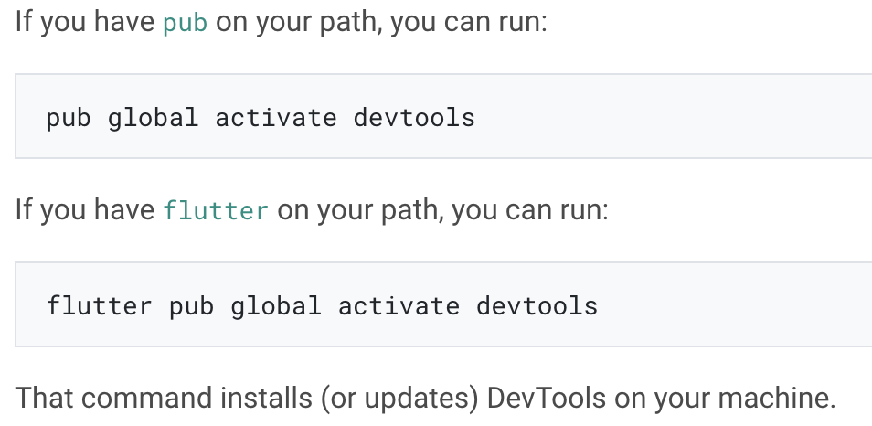
Install and run DevTools from the command line
Install DevTools

Slide 53
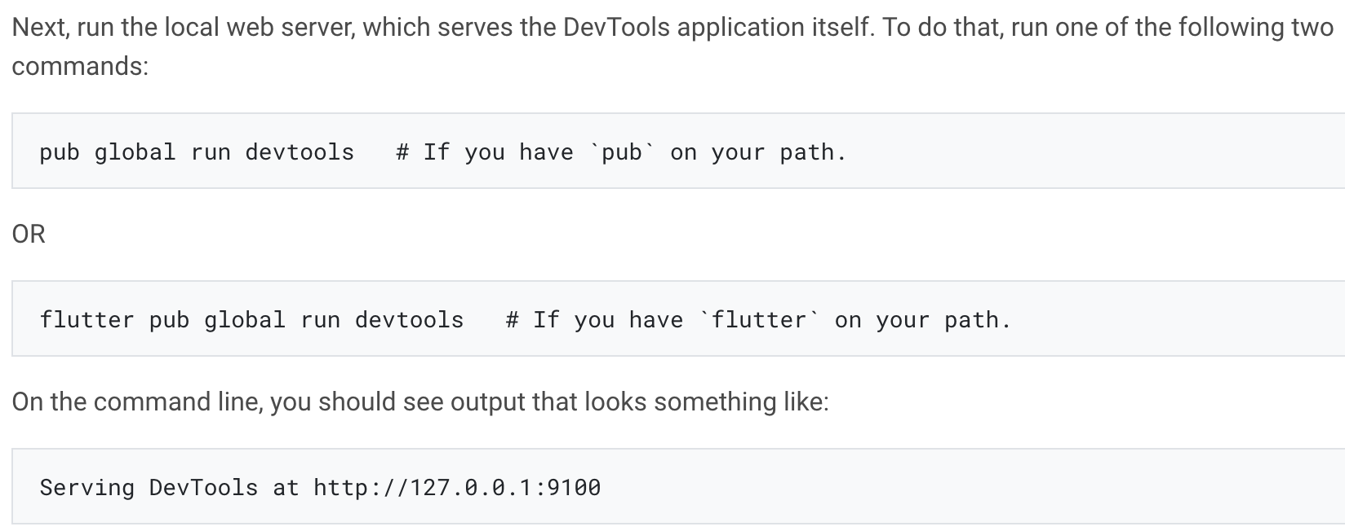
Launch the DevTools application server

Slide 54
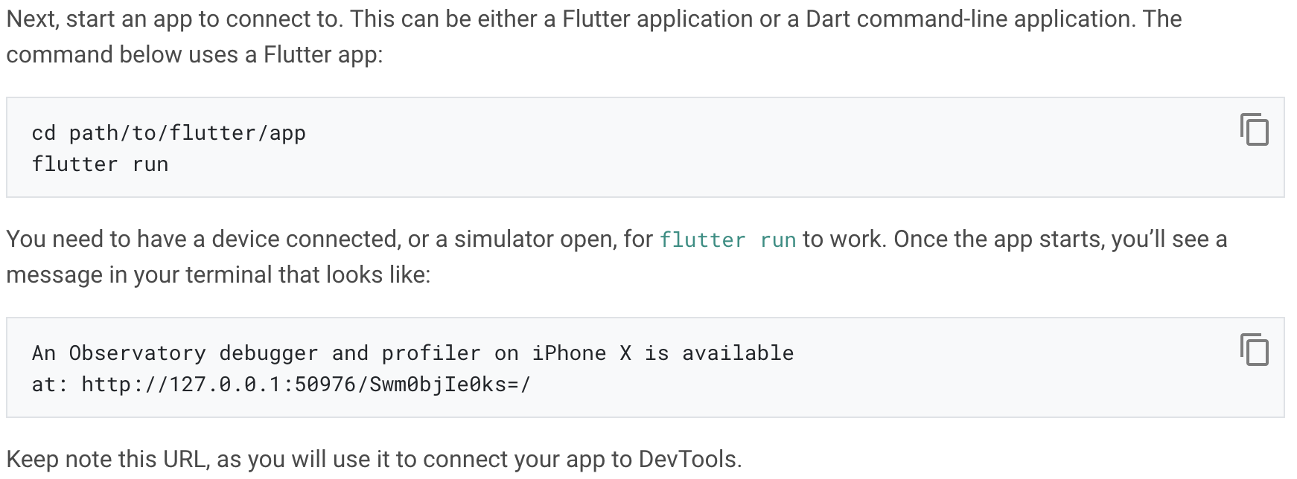
Start an application to debug

Slide 55
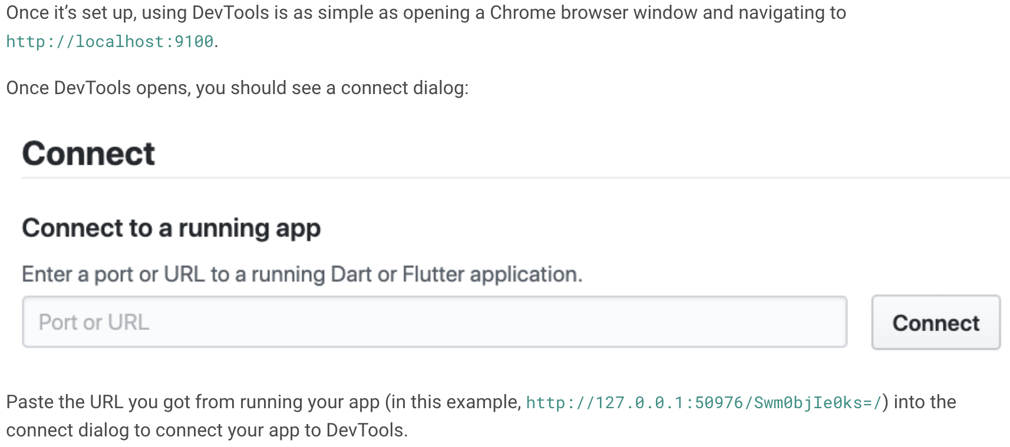
Open DevTools and connect to the target app

Slide 56
Using the Flutter inspector
What is it?
The Flutter widget inspector is a powerful tool for visualizing and exploring Flutter widget trees.

Slide 57
Get started
To debug a layout issue, run the app in debug mode and open the inspector by clicking the Flutter Inspector tab on the DevTools toolbar.
Note: You can still access the Flutter inspector directly from Android Studio/IntelliJ, but you might prefer the more spacious view when running it from DevTools in a browser.

Slide 58
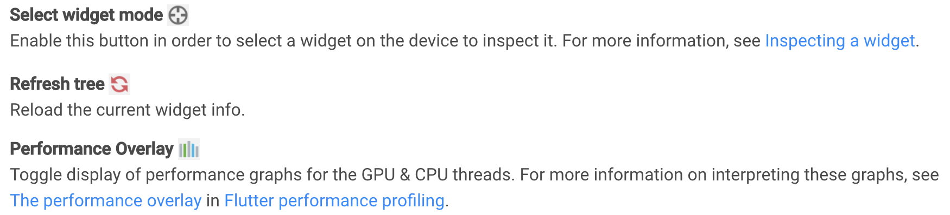
Debugging layout issues visually

Slide 59
Inspecting a widget
You can browse the interactive widget tree to view nearby widgets and see their field values.
To locate individual UI elements in the widget tree, click the Select Widget Mode button in the toolbar.
When debugging layout issues, the key fields to look at are the size and constraints fields.

Slide 60
Track widget creation
When launching an application from an IDE, the source instrumentation happens by default. For command line launches, you need to opt-in to the source instrumentation. To do this, run the app with the --track-widget-creation flag:

Slide 61
Here are examples of what your widget tree might look like with and without track widget creation enabled.
Track widget creation enabled (recommended):

Slide 62
Using the Timeline view
What is it?
The timeline view displays information about Flutter frames. It consists of three parts, each increasing in granularity.
Frame rendering chart
Frame events chart
CPU profiler

Slide 63
Frame rendering chart
This chart is populated with individual frames as they are rendered in your application. Each bar in the chart represents a frame.

Slide 64
Frame events chart
The frame events chart shows the event trace for a single frame. The top-most event spawns the event below it, and so on.

Slide 65
CPU profiler
This section shows CPU profiling information for a specific event from the frame events chart (Build, Layout, Paint, etc).
Profile granularity: The default rate at which the VM collects CPU samples is 1 sample / 250 μs. This is selected by default on the Timeline view as “Profile granularity: medium”.

Slide 66
Flame chart: This tab of the profiler shows CPU samples for the selected frame event (such as Layout in the following example).

Slide 67
Call tree: The call tree view shows the method trace for the CPU profile.

Slide 68
Bottom up: The bottom up view shows the method trace for the CPU profile but, as the name suggests, it’s a bottom-up representation of the profile.

Slide 69
Using the Memory view
What is it?
Allocated Dart objects created using a class constructor (for example, by using new MyClass() or MyClass()) live in a portion of memory called the heap.
Memory profiling consists of four parts, each increasing in granularity:
Memory overview chart
Event timeline
Snapshot classes
Class instances

Slide 70
Memory anatomy
Use a timeseries graph to visualize the state of the Flutter memory at successive intervals of time.

Slide 71
Memory overview chart
This chart is a timeseries graph to help visualize the state of the heap at various points in time.

Slide 72
Event timeline
This chart displays DevTools events (such as Snapshot and Reset button clicks) in relation to the memory chart timeline.

Slide 73
Snapshot classes
This pane shows classes allocated in the heap, total instances, total bytes allocated, and an accumulator of allocations since the last reset.

Slide 74
Memory actions

Slide 75
Using the Performance view
What is it?
The performance view allows you to record and profile a session from your Dart application.
CPU Profiler
Start recording a CPU profile by clicking Record. When you are done recording, click Stop. At this point, CPU profiling data is pulled from the VM and displayed in the profiler views (Call Tree, Bottom Up, and Flame Chart).

Slide 79
Using the debugger
Getting started
DevTools includes a full source-level debugger, supporting breakpoints, stepping, and variable inspection.

Slide 80
Setting breakpoints
To set a breakpoint, click the left margin (the line number ruler) in the source area. Clicking once sets a breakpoint, which should also show up in the Breakpoints area on the left. Clicking again removes the breakpoint.

Slide 81
The call stack and variable areas
When your application encounters a breakpoint, it pauses there, and the DevTools debugger shows the paused execution location in the source area.
Within the Variables area, you can inspect individual objects by toggling them open to see their fields.

Slide 82
Stepping through source code
When paused, the three stepping buttons become active.
Use Step in to step into a method invocation, stopping at the first executable line in that invoked method.
Use Step over to step over a method invocation; this steps through source lines in the current method.
Use Step out to step out of the current method, without stopping at any intermediary lines.
In addition, the Resume button continues regular execution of the application.

Slide 83
Console output
Console output for the running app (stdout and stderr) is displayed in the console, below the source code area. You can also see the output in the Logging view.

Slide 84
Breaking on exceptions
To adjust the break-on-exceptions behavior, toggle the Break on unhandled exceptions and Break on all exceptions checkboxes in the upper right of the debugger view.
Breaking on unhandled excepts only pauses execution if the breakpoint is considered uncaught by the application code.
Breaking on all exceptions causes the debugger to pause whether or not the breakpoint was caught by application code.

Slide 85
Using the Logging view
What is it: The logging view displays events from the Dart runtime, application frameworks (like Flutter), and application-level logging events.
Standard logging events

Slide 86
Logging from your application: To implement logging in your code, see the Logging section in the Debugging Flutter apps programmatically page.
Clearing logs: To clear the log entries in the logging view, click the Clear logs button.

Slide 87
Hot reload
Notes:
StatelessWidget is used for immutable elements that only rely on the object configuration information
StatefulWidget is used for elements that can dynamically change based on state-changes in the system
Everytime that state changes, setChange() is called by the object

Slide 88
Introduction
Flutter’s hot reload feature helps you quickly and easily experiment, build UIs, add features, and fix bugs.
Hot reload works by injecting updated source code files into the running Dart Virtual Machine (VM).

Slide 89
To hot reload a Flutter app:
Run the app from a supported Flutter editor or a terminal window. Either a physical or virtual device can be the target. Only Flutter apps in debug mode can be hot reloaded.
Modify one of the Dart files in your project. Most types of code changes can be hot reloaded; for a list of changes that require a hot restart, see Limitations.
If you’re working in an IDE/editor that supports Flutter’s IDE tools, select Save All (cmd-s/ctrl-s), or click the Hot Reload button on the toolbar:

Slide 90
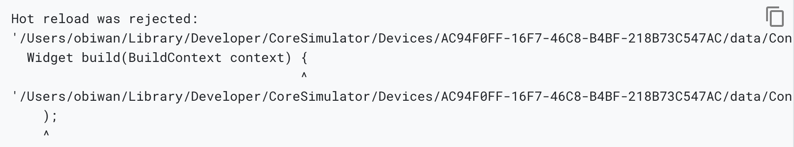
Compilation errors
When a code change introduces a compilation error, hot reload always generates an error message similar to:

Slide 91
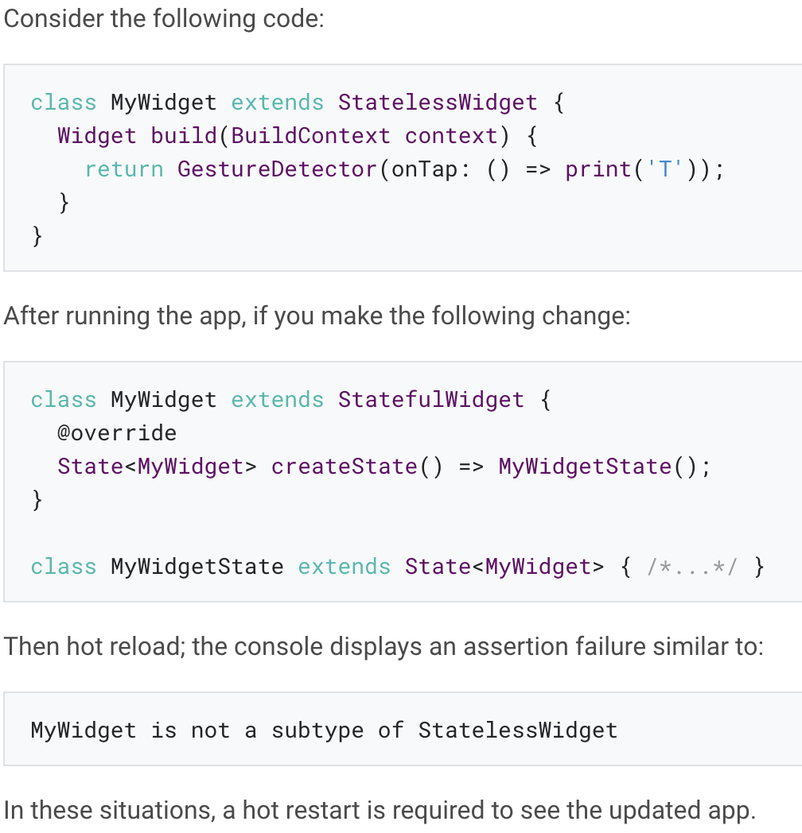
Previous state is combined with new code
Flutter’s Stateful Hot Reload preserves the state of your app.
This design enables you to view the effect of the most recent change only, without throwing away the current state.
However, the state might not be compatible with the new changes.

Slide 92
Recent code change is included but app state is excluded
In Dart, static fields are lazily initialized.
This means that the first time you run a Flutter app and a static field is read, it is set to whatever value its initializer was evaluated to.
If you change initializers of global variables and static fields, a full restart is necessary to see the changes.

Slide 93
Recent UI change is excluded
Even when a hot reload operation appears successful and generates no exceptions, some code changes might not be visible in the refreshed UI.
This behavior is common after changes to the app’s main() method.

Slide 94
Limitations
You might also encounter the rare cases where hot reload is not supported at all. These include:
Changes on initState() are not reflected by hot reload. A hot restart is required.
Enumerated types are changed to regular classes or regular classes are changed to enumerated types.
Generic type declarations are modified.

Slide 95
How it works
When hot reload is invoked, the host machine looks at the edited code since the last compilation.
The following libraries are recompiled:
Any libraries with changed code
The application’s main library
The libraries from the main library leading to affected libraries

Slide 96
Thank you!
Wenxuan Shi
College of Software, Nankai University
Email: shiwx@nankai.edu.cn
Wechat: 13920561100

